Slide 1

Cyber crime
By navneeth, Nishanth and anurag

Slide 2
What is cyber crime?
Cybercrime is any criminal activity that involves a computer, networked device or a network.
Most cybercrime is committed by cybercriminals or hackers who want to make money.

Slide 3

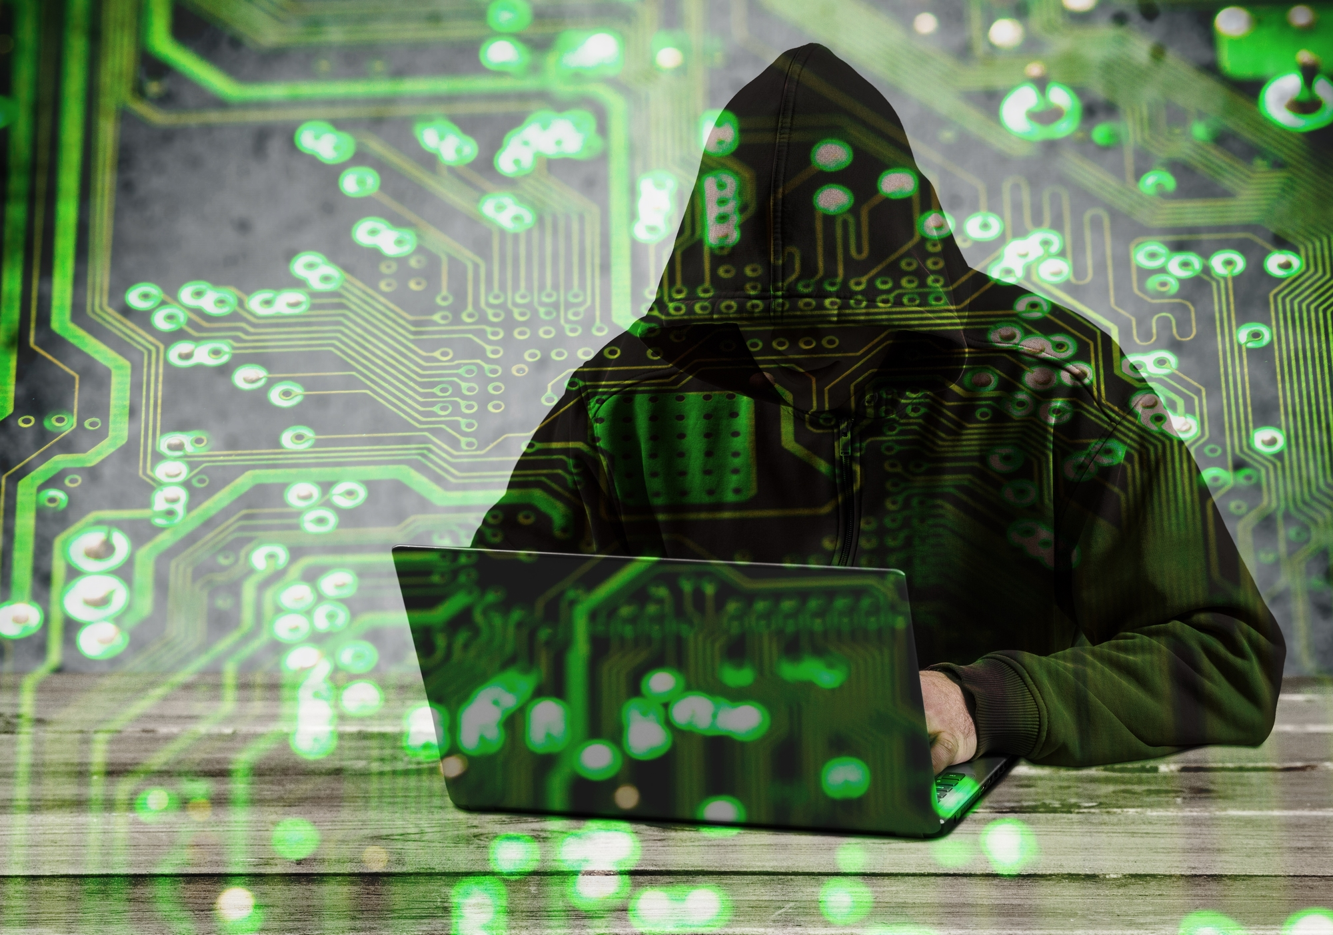
hacking
Hacking is the act of compromising digital devices and networks through unauthorized access to an account or computer system. Hacking is not always a malicious act, but it is most commonly associated with illegal activity and data theft by cyber criminals.
Misuse of devices like computers, smartphones, tablets, and networks to cause damage to or corrupt systems, gather information on users, steal data and documents, or disrupt data-related activity.
It is a multibillion-dollar industry with extremely sophisticated and successful techniques.

Slide 4
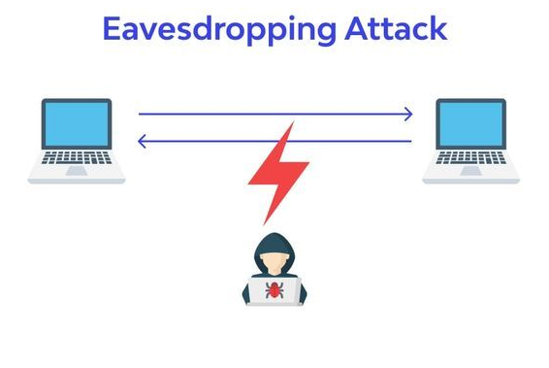
Eavesdropping
An eavesdropping attack occurs when a hacker intercepts, deletes, or modifies data that is transmitted between two devices.
Relies on unsecured network communications to access data in transit between devices.
The data is transmitted across an open network, which gives an attacker the opportunity to exploit a vulnerability and intercept it via various methods.

Slide 5
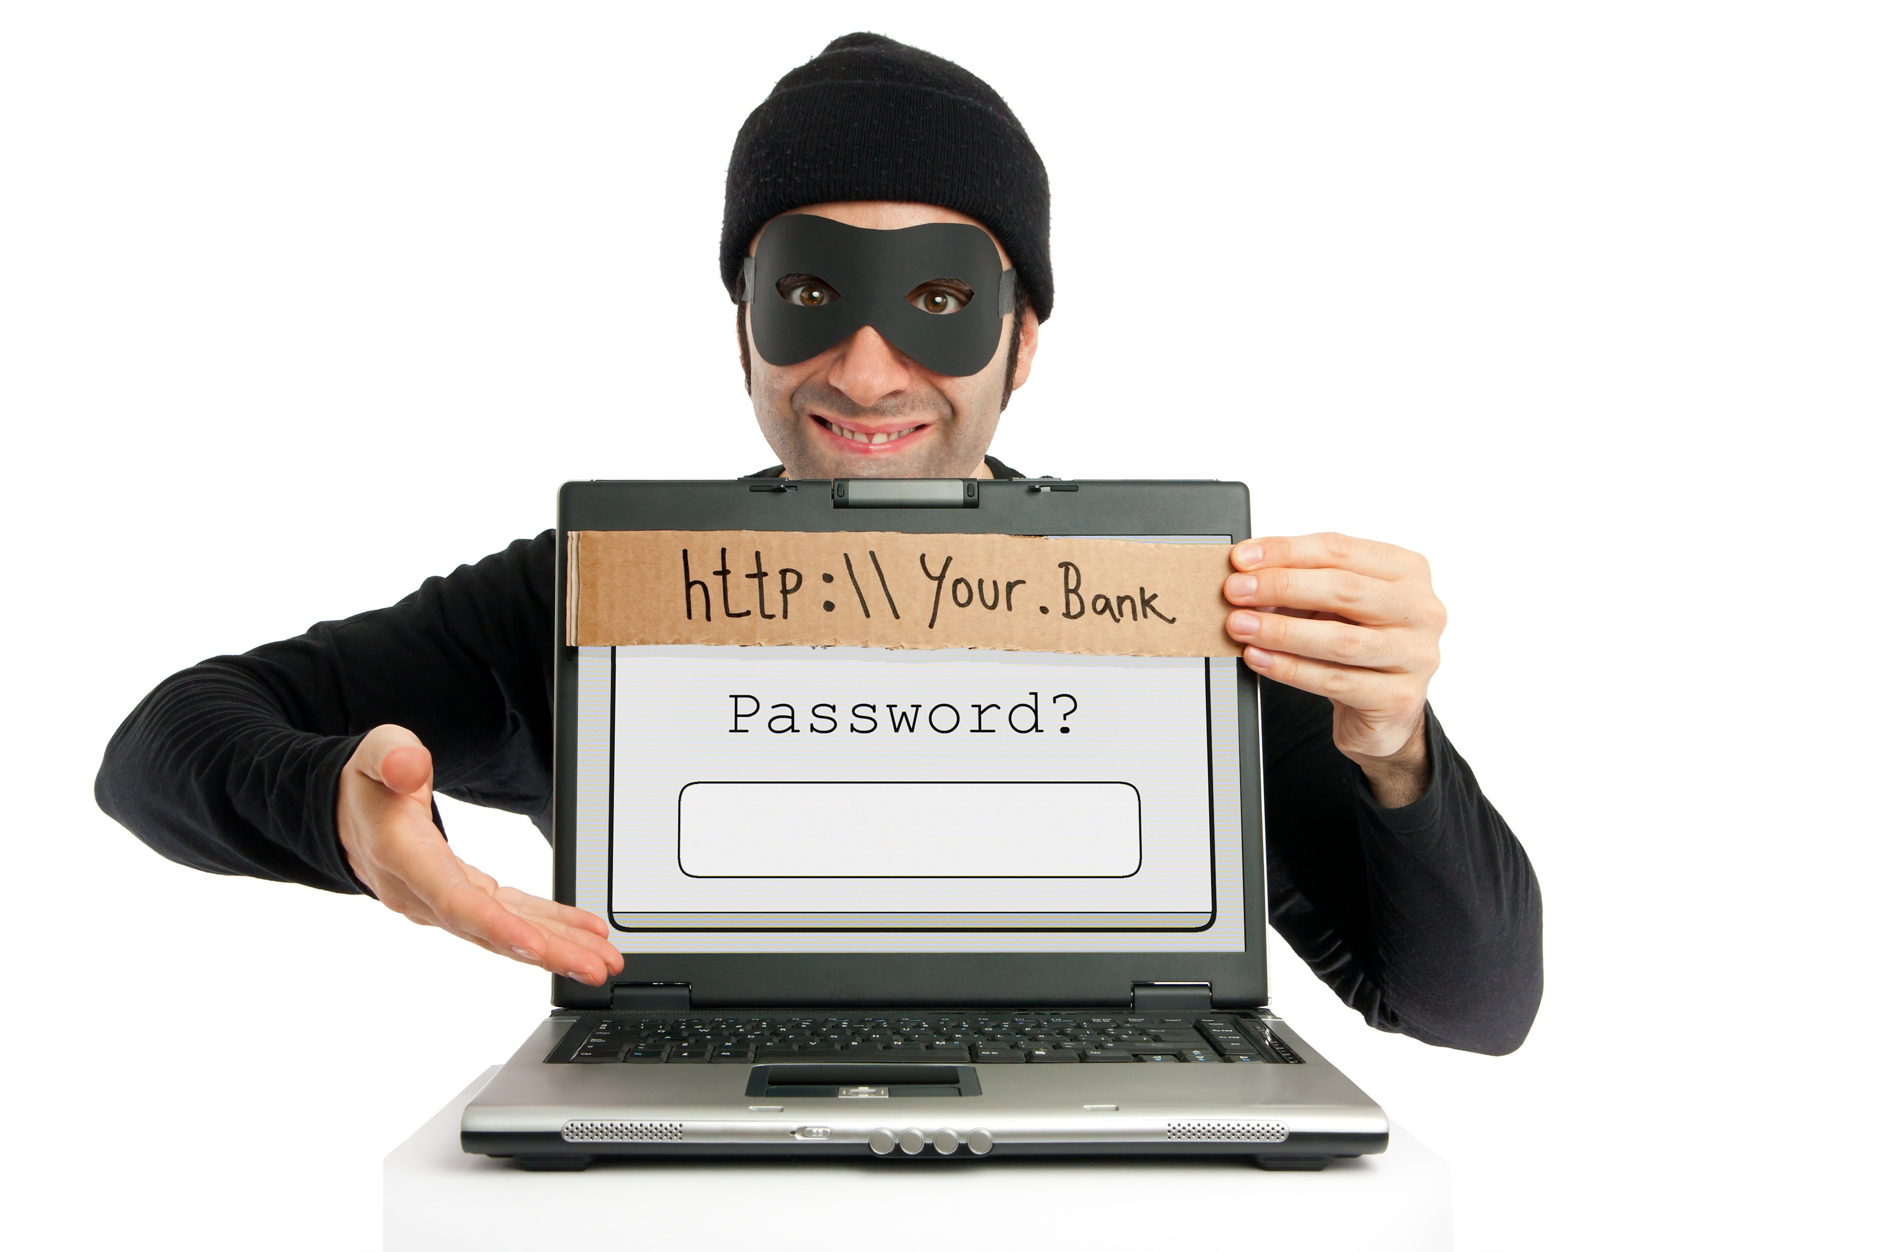
phishing
Phishing is a cybercrime in which a target or targets are contacted by email, telephone or text message by someone posing as a legitimate institution to lure individuals into providing sensitive data such as personally identifiable information, banking and credit card details, and passwords.
The information is then used to access important accounts and can result in identity theft and financial loss.

Slide 6

Cyber bullying
Cyberbullying is the use of technology to harass, threaten, embarrass, or target another person. Online threats and mean, aggressive, or rude texts, tweets, posts, or messages all count. So does posting personal information, pictures, or videos designed to hurt or embarrass someone else.
The police could get involved, and bullies may face serious penalties.
Intimidation or mean comments that focus on things like a person's gender, religion, sexual orientation, race, or physical differences count as discrimination, which is against the law in many states.

Slide 7
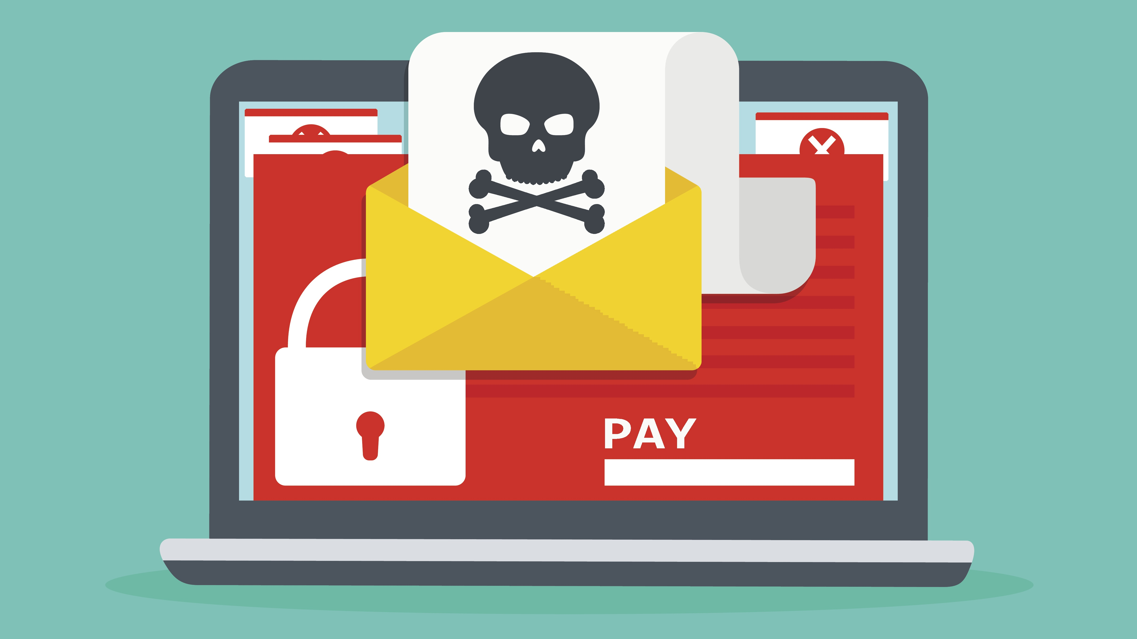
Ransomware
Ransomware is malware that employs encryption to hold a victim’s information at ransom.
A user or organization’s critical data is encrypted so that they cannot access files, databases, or applications. A ransom is then demanded to provide access.
It is a growing threat, generating billions of dollars in payments to cybercriminals and inflicting significant damage and expenses for businesses and governmental organizations.

Slide 8
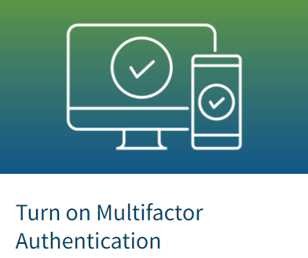


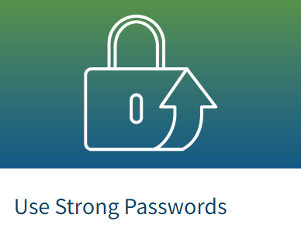
How to be safe from cyber attacks
Notes:
2 fac auth… turn on auto updates… more than 90% cyber attcks start with phishing email… password manager to store and gen unique pass…

Slide 9

Thank You

